Slide 1
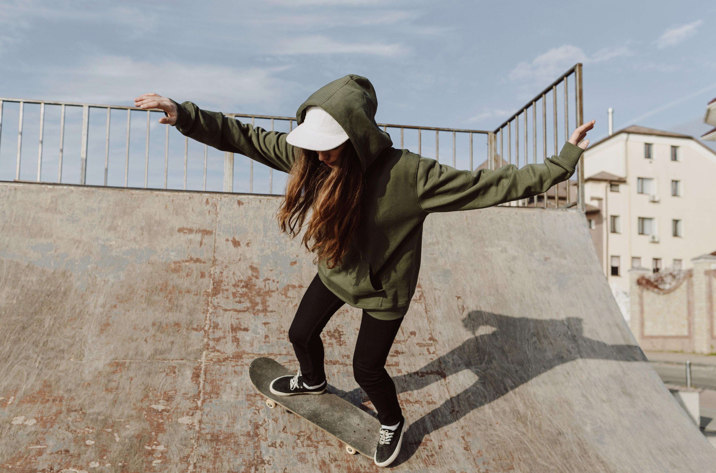


Start your BRONZE
or SILVER DofE
Notes:
Introductions. Use the chat box to introduce yourself and if you’ve ever heard of the DofE.

Slide 2
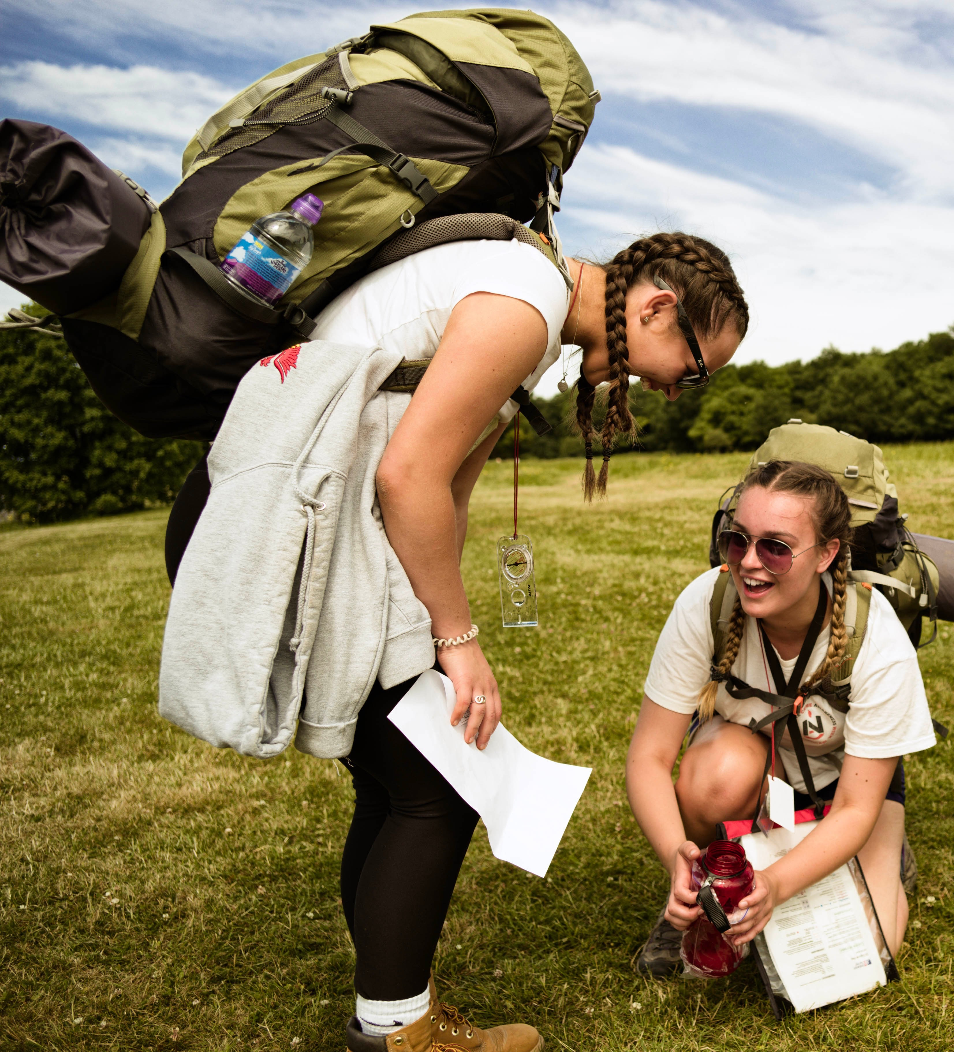

Purpose of tonight
Provide an overview of the Duke of Edinburgh programme
Ensure all parents and students are aware of each section of the Award and know how to get started
Ensure all parents and students are aware of how to signed up to edofe and start logging their activities (students Tues 11th Nov 3 – 4pm)
Provide an overview of the practice and assessment Expedition details (Thursday 26th March, 4.30pm, Expedition Information Evening)
Answer any questions that you may have.
Notes:
Learn soft skills like communication, resilience, team work.
GCSE’s don’t require you to work as a team to get but The DofE does.

Slide 3
Why do the DofE?
A life-changing adventure which will help you develop the skills you need for your future life and work. ​
Helps you stand out from the crowd when applying for jobs, colleges or universities.
Notes:
Learn soft skills like communication, resilience, team work.
GCSE’s don’t require you to work as a team to get but The DofE does.

Slide 4
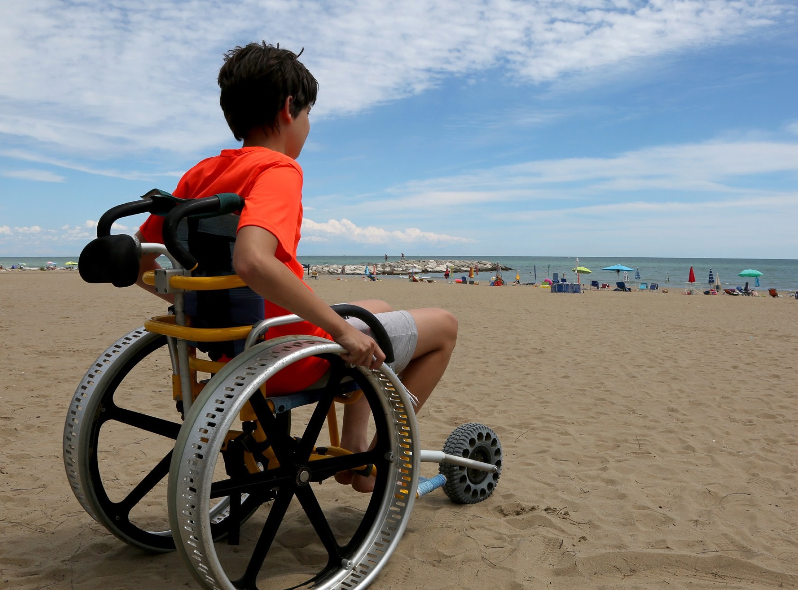

Who can do it?
-The DofE is open to everyone – No matter what your starting point, it'll be an adventure.
-You set your own goals that are achievable for you.
Notes:
​

Slide 5
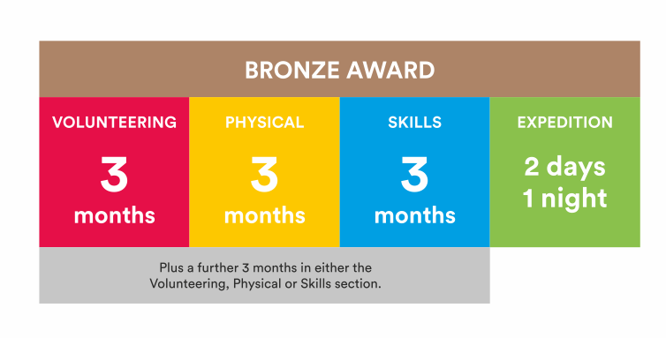
What's involved?
Notes:
​

Slide 6
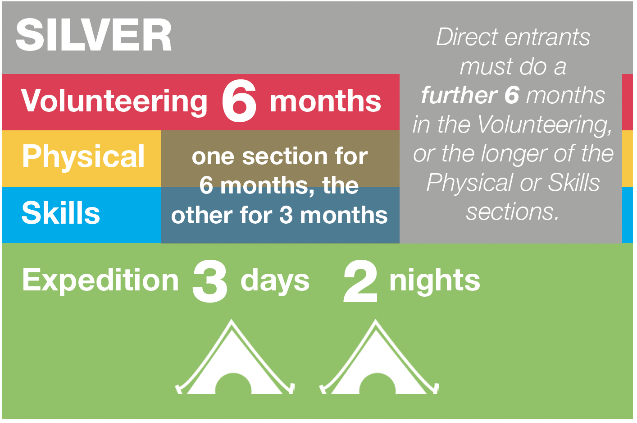
What's involved?
Notes:
​

Slide 7
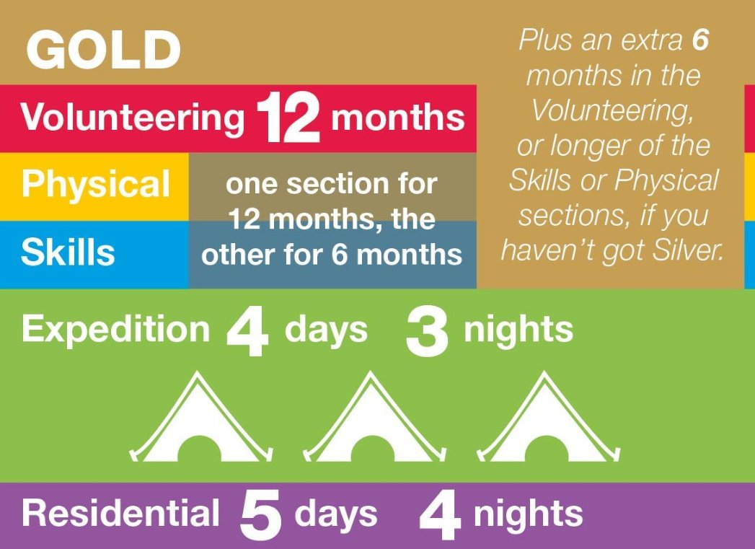
What's involved?
Notes:
​

Slide 8

Volunteering section
Take action and make a difference to the causes you care about
Help others and change things for the better
Notes:
Volunteering is a chance to help other people, and to make a difference to the causes you feel most passionate about.​
As well as changing things for the better, lots of young people find that volunteering is a great way to increase their confidence and gain new skills.​
Not a business

Slide 9
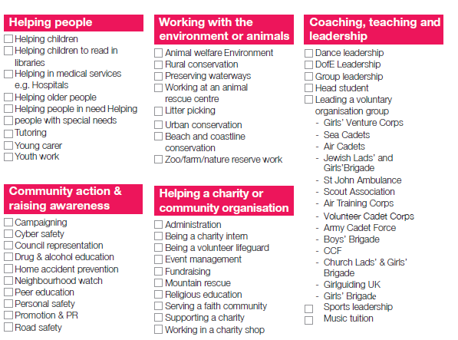
Volunteering section
- Helping older people
Raising Money
Animal Shelter
Litter Picking
Sport Coaching
Park Run
DofE Young Leader
Notes:
You can choose to volunteer in any area you would like – the only rule is that you must not be doing a job that companies would normally pay somebody for.​

Slide 10
Physical section
Take part in whatever
dance, sport or ﬁtness
activity you would like
Get ﬁtter and have fun
along the way!
Notes:
Becoming more active can be a huge amount of fun, and it can also help you feel happier and healthier.
​

Slide 11
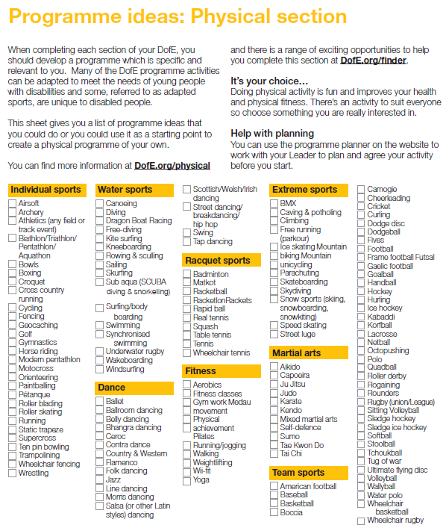
Physical section ideas
Swimming
Rugby
Gym
School clubs
Couch to 5k
Mountain Biking
Yoga
Notes:
​

Slide 12
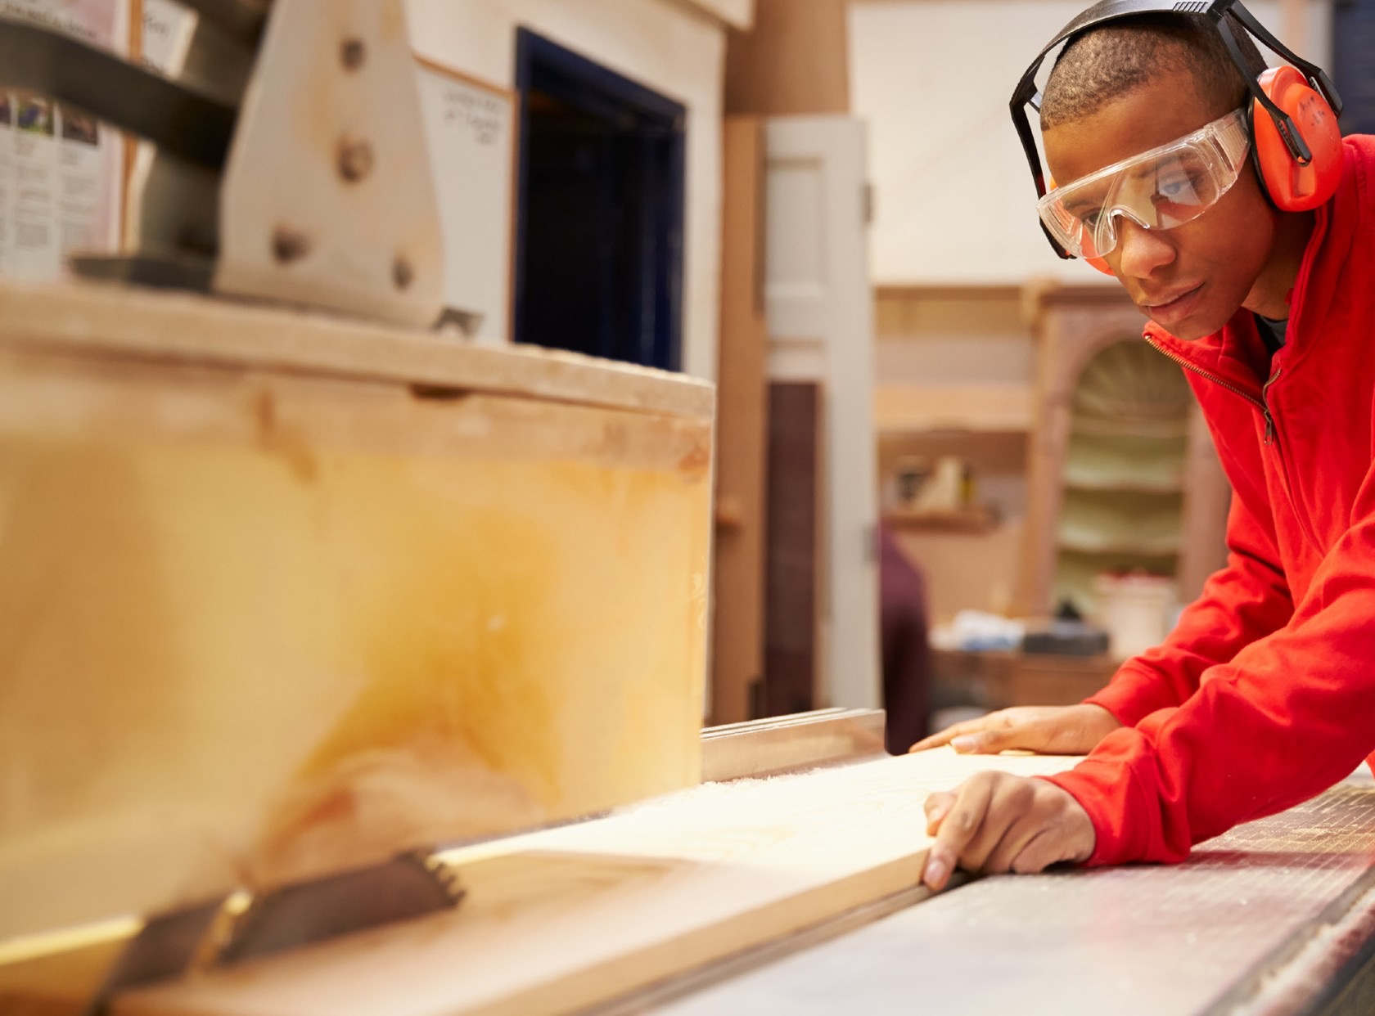
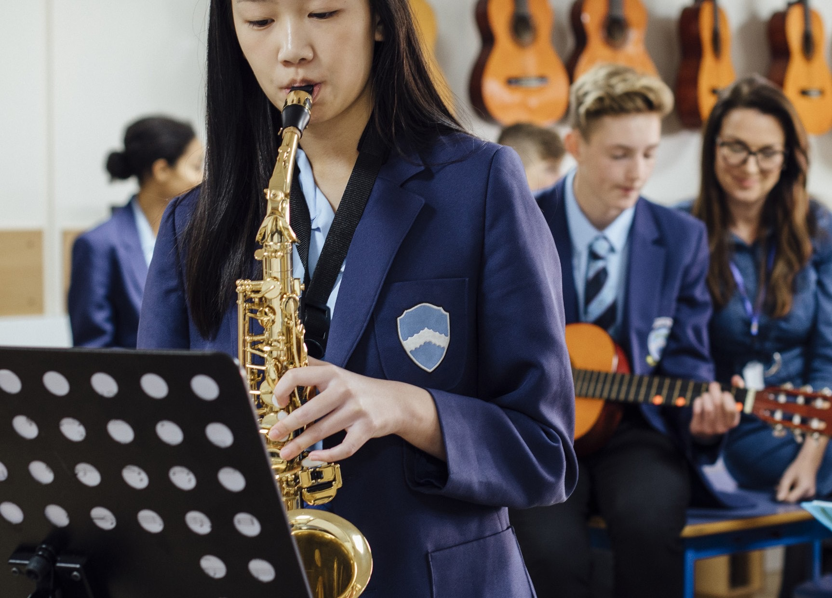
Skills section
Devote yourself to improving your skills in the things you love to do
Discover new passions and develop talents you didn’t know you had
Notes:
Skill and Physical difference
You can decide whether you will try to get better at something you already feel passionate about, or learn to do something new.
​

Slide 13
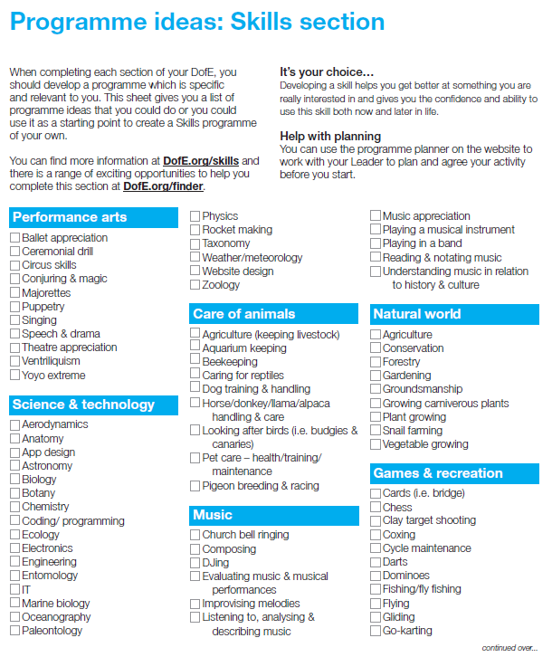
Skills section ideas
Drama, Music
Computer coding
Fishing
Photography, art, craft
Cooking
Duolingo
Reading, Writing
Driving
First Aid
Notes:
In the past, young people have done a huge range of different activities for their skills section, such as computer coding, driving and cooking.
Gaining new interests and talents is a huge amount of fun and lots of young people also feel a real sense of achievement from doing it.
Again this cant be in school time but could be a school club for example book club
​

Slide 14
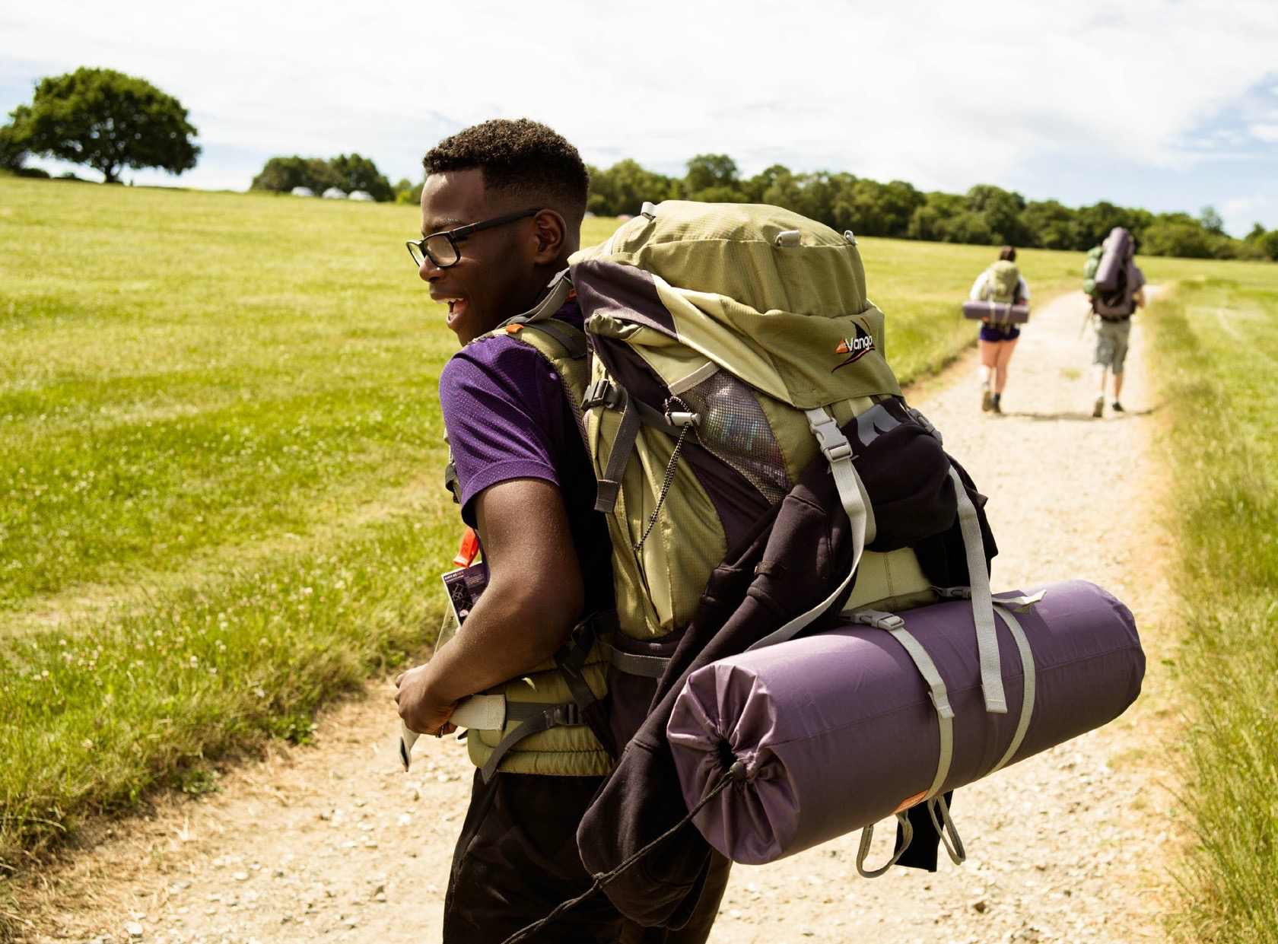

Expedition
Create memories that will last a lifetime
Planning, training for and completion of an adventurous journey
Notes:
The final section of your Bronze DofE Award is the Expedition.​
​As part of a small team, you’ll plan your aim, choose your location and do some training to make sure you’re prepared and know what you’re doing — then spend two days and one night away.​
​Your Expedition will improve your resilience, communication, teamwork and leadership skills. ​
​

Slide 15
What Will I Do?
You will work on each section on average an hour a week
Record how much time you spend on each activity
Ask someone with a good understanding of the activity to be your assessor and write an assessor's report at the end
Notes:
You will work on each section on average an hour a week
You will need to keep a record of the time you spend on each activity.
Ask someone with a good understanding of the activity to be your assessor and write an assessors report at the end
​

Slide 16


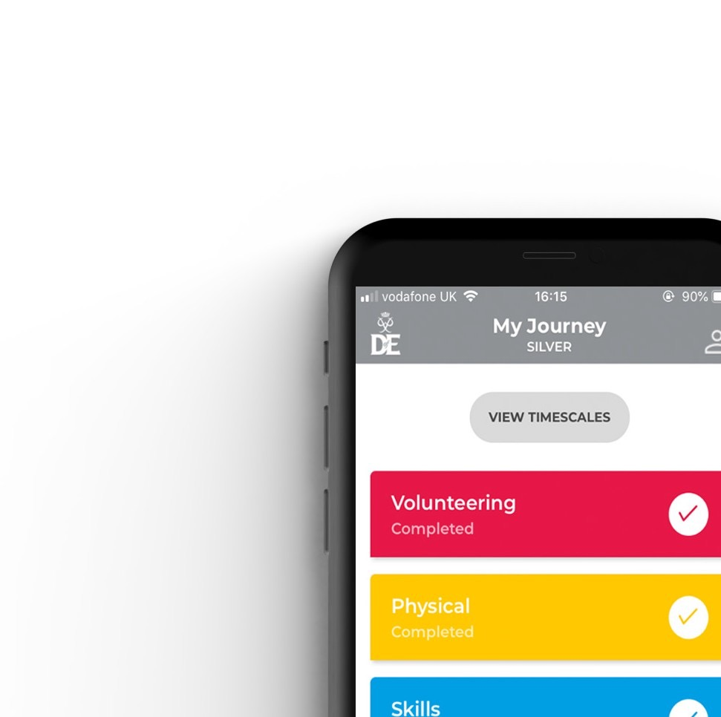


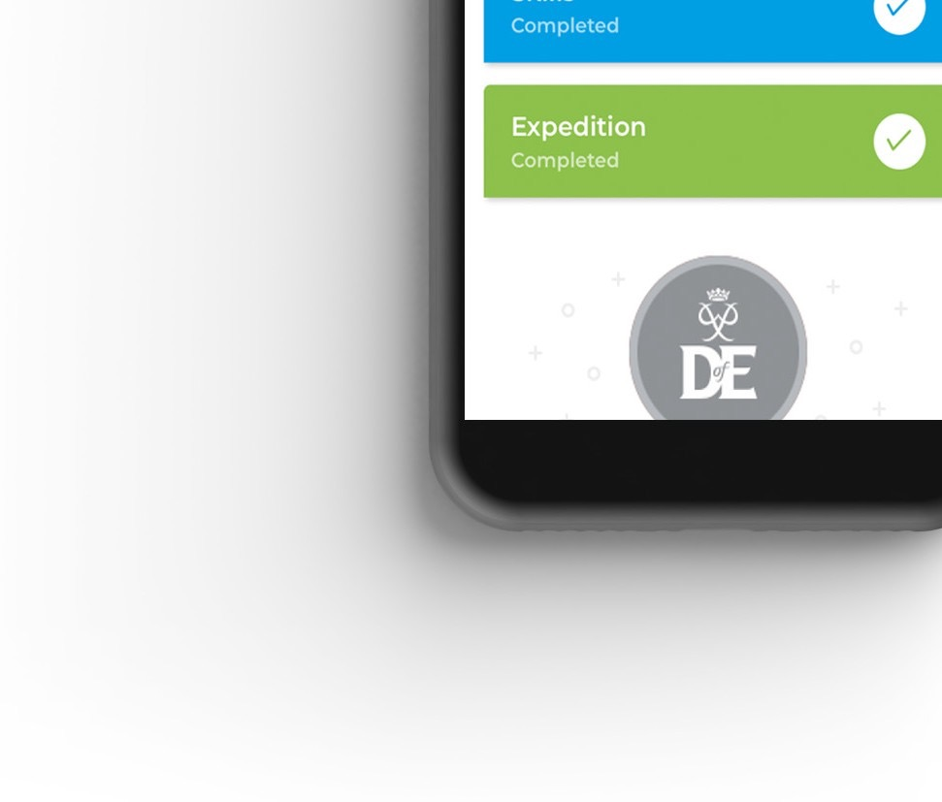
Your Welcome Pack and eDofE
Notes:
Once you have signed up to do your DofE, you will receive a Welcome Pack in the post which contains lots of useful information and advice. ​
​You will also get your own eDofE account so that you can plan your activities online using the free DofE app.​
​You will also receive a DofE Card which will give you and your family money off in several shops selling the sorts of equipment you may need.​

Slide 17
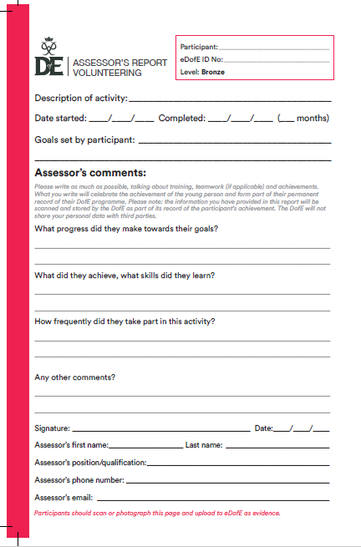
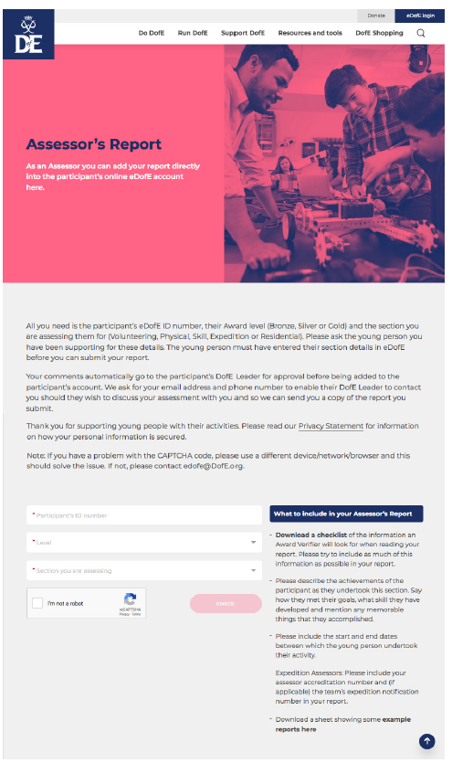
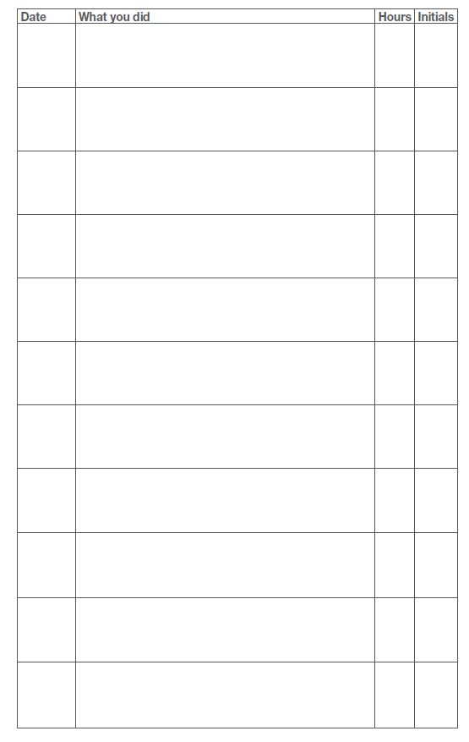
Evidence
Must have an assessor's report
Diary log sheet

Slide 18
Top Tip
Remember you can use activities/hobby's you're already doing towards your DofE
You don’t have to do it on your own, you can do it in a group
Notes:
You will work on each section on average an hour a week
You will need to keep a record of the time you spend on each activity.
Ask someone with a good understanding of the activity to be your assessor and write an assessors report at the end
​

Slide 19
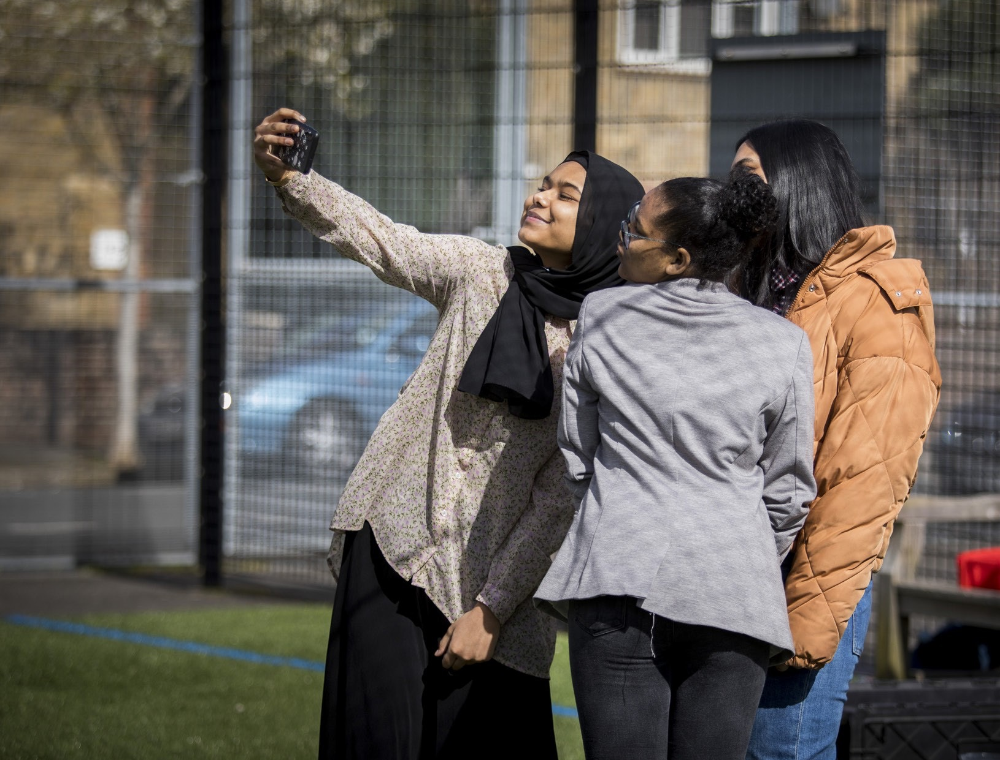
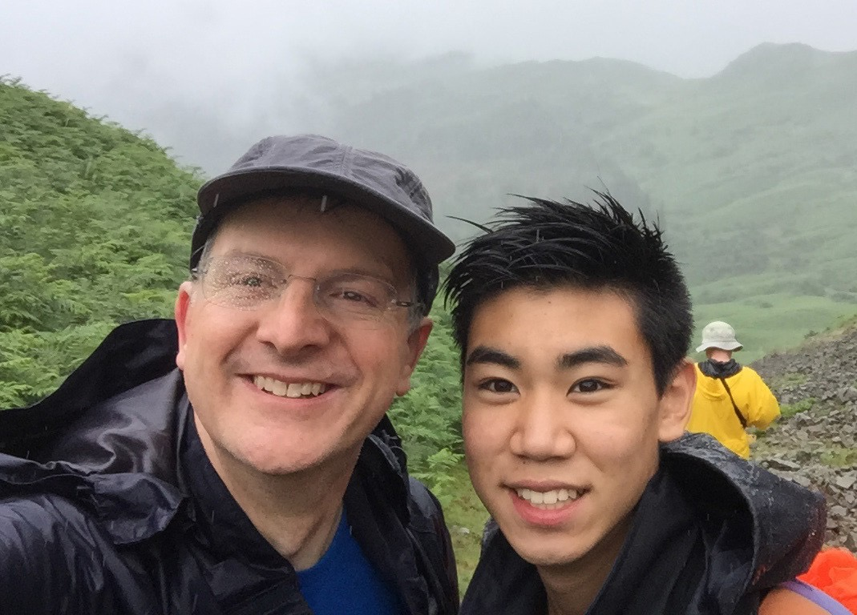
Your Role
- Guidance
- Encouragement
- Practical support
- Recognising achievement
Notes:
There are several ways you can help your young person to achieve their DofE Award.​
​You should provide guidance and advice – support them with things like choosing their activities and finding assessors.
Encouragement - It can be challenging to keep the motivation going, especially over some of the longer timeframes.​
​If they need it, help keep them on track with their activities, particularly those which are being done from home.​
​Practical support - You may be required to drop off/collect from expeditions and activities, make sure they have all the right kit and also wash the kit when it comes home! ​
​Recognising achievement - We hope all organisations will recognise the amazing achievement, and it is just as important to receive that recognition from family members. ​
​

Slide 20
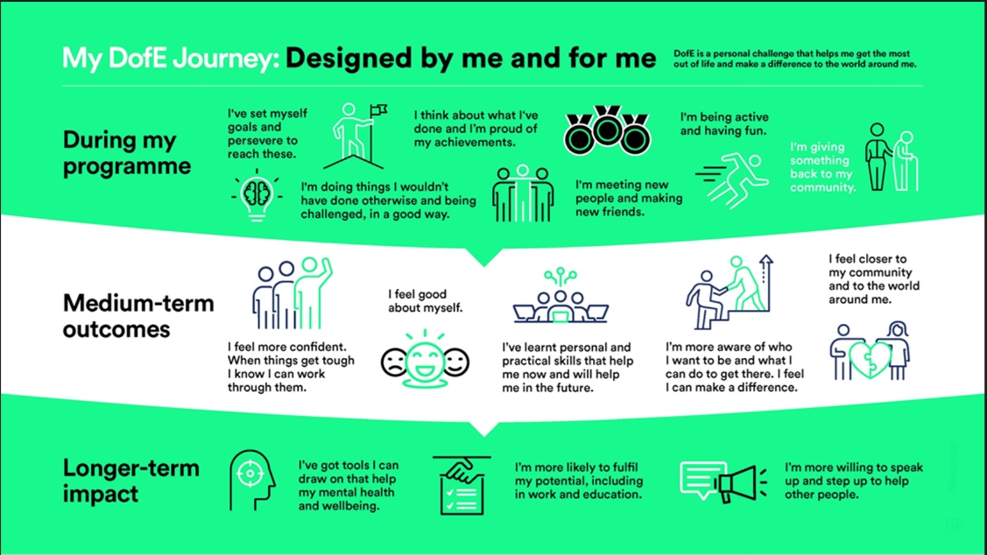
Top Tip
Notes:
You will work on each section on average an hour a week
You will need to keep a record of the time you spend on each activity.
Ask someone with a good understanding of the activity to be your assessor and write an assessors report at the end
​

Slide 21

Pack contents
Copy of tonight's presentation
Overview letter
DofE enrolment form
Programme ideas – for each section – Physical, Skills and Volunteering
Activity Log – for each section – Physical, Skills and Volunteering
Assessor report cards – for each section – Physical, Skills and Volunteering
Expedition kit list
Notes:
Presenter: Please customise this slide with the contact details of your DofE leader/administrator.
​Explain the next steps.
​
​

Slide 22
Ruskin
October – December:
Sign up and after school sessions to support students choosing sectional activities and using edofe
Jan – July:
After school Expedition Training (these may not be every week). Aim to prepare students for both practice/assessment.
June:
Practice Expedition (prior to this we expect students to have completed one of their sections)
July
Assessment Expedition
Notes:
You will work on each section on average an hour a week
You will need to keep a record of the time you spend on each activity.
Ask someone with a good understanding of the activity to be your assessor and write an assessors report at the end
​

Slide 23

After school sessions
Edofe sessions; sign up and logging of activities
Mostly onsite at Ruskin, although, we will plan one or two offsite map reading sessions.
Wednesday 12th November 3 – 4pm sign up session.
After Christmas we will confirm when we will run the expedition training sessions which will cover:
  Packing rucksack
  Set up a camp/tent
  Cooking
  Teamwork
  Map reading and route planning – we may run some off site
  Aim's for assessment

Slide 24
Expedition dates
Please make sure that you are available and contactable over the weekend. It is very rare that a student has to be collected, though occasionally it does happen.
Bronze
Practice expedition – Saturday 16th and Sunday 17th May 2026, Beeston area.
Assessment expedition – Saturday 11th and Sunday 12th July 2026, Llangollen.
Silver
Practice expedition – Friday 15th to Sunday 17th May 2026, Beeston area.
Assessment expedition – Friday 10th to Sunday 12th July 2026, Llangollen.
Notes:
You will work on each section on average an hour a week
You will need to keep a record of the time you spend on each activity.
Ask someone with a good understanding of the activity to be your assessor and write an assessors report at the end
​

Slide 25
Getting There and Home!
This is not included in the costs.
Parents or a family member are required to drop students off at the meeting point and collect them on the Sunday.
If you will really struggle to get there, please team up with a friend.

Slide 26
Supervision Whilst Walking
Practice
Assessment
This will be mostly direct, although, some groups may be given opportunities to be more independent.
There will be some free time in camp during the evening but all will remain near to staff. (This will be the same for assessment)
This will involve a mixture of direct, close and remote supervision, depending on the risk assessment of each group following the practice expedition and training sessions.
Staff will be at check-points.

Slide 27
Supervision Continued…
The Expedition Requirements state that the expedition is unaccompanied and self-sufficient without outside assistance. For this objective to be met, groups cannot be “led” by their instructor, rather they must be under their own steam and making decisions themselves along the way. However, we are still responsible for the safety of the group, so they must be monitored throughout and we do this by remote supervision.
We are working to achieve the correct balance of safety and supervision, so that the group feel like they are on their own rather than knowing they are being closely shadowed, watched or monitored in any way – it is their experience and it should remain feeling like this. Our aim, therefore, is that remote supervision feels just that – unobtrusive.

Slide 28

Kit – Key things
What will borrow from Ruskin
What you need to provide
Kit list in your pack
Some key items…
  Walking shoes – broken in! (DO NOT NEED TO BE WALKING BOOTS)
  Walking socks
  Sleeping bag
  Walking trousers – NOT JEANS
  Torch
  Personal first aid kit
  Waterproofs
Tents
Stoves
Fuel for stoves
Maps
Compasses
Rucksack
Loan things from family and friends where possible!
No need to buy new!

Slide 29
Photos

Slide 30

Payments
£35 to register
Expedition fee TBC. Approx £100
We aim to keep DofE affordable to everyone, therefore, once all students are signed up for the year we will work out the overall cost and split between those signed up.
Please ensure any outstanding payments are made by Easter holidays.

Slide 31
Evidence Parents/Carers PLease help!
Must have an assessor's report
Diary log sheet
www.dofe.org/assessor/

Slide 32
Thank you
Tuesday 11th November 3 – 4pm sign up session – this is for students
Parents/carers - please support your child with their physical, skill and volunteering sections. Make sure they have an appropriate assessor and know how to sign off section when complete.
Parent/Carers Expedition Evening – Thursday 26th March 2026 4.30pm - this is for parents/carers and students
Any Questions?
Notes:
Presenter: Please customise this slide with the contact details of your DofE leader/administrator.
​Explain the next steps.
​
​

